Slide 1
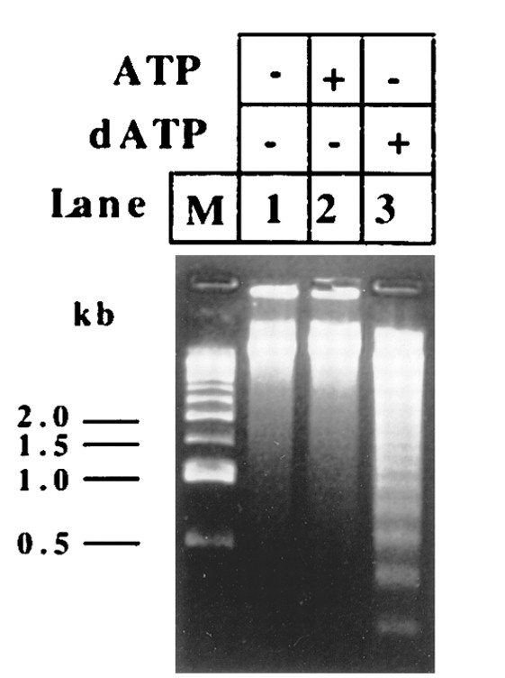
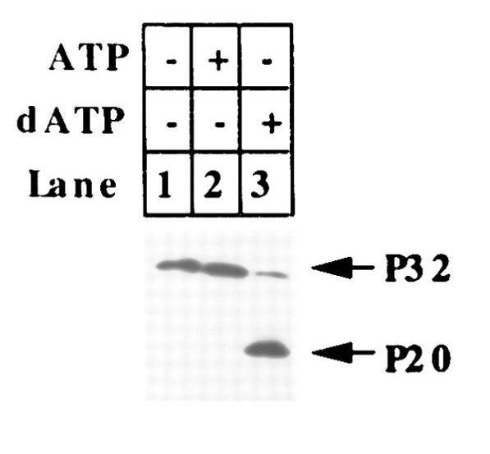
How Are Caspases Activated
Xiao-dong Wang first set up an in vitro cell-free system to study the caspase activation process
His group found that dATP can trigger caspase-3 activation in S100 Hela cell extracts.
Caspase-3
Adapted from Liu et al. Cell 86 147-157, 1996

Slide 2
Purification of Caspase Activating Factors
S100+dATP
Phosphocellulose column
Bound
Flow-through
Hydroxylapatite column
Flow-through
Bound
Pinkish protein
Apaf-2
(Cytochrome C)
Apaf-3
(capase-9)
Apaf-1
(CED-4)

Slide 3
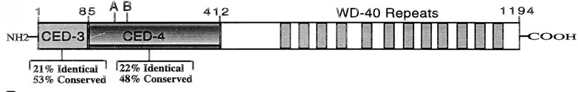
Apaf-1 Is Similar to CED-4
Adapted from Zou et al. Cell 86 147-157, 1997

Slide 4
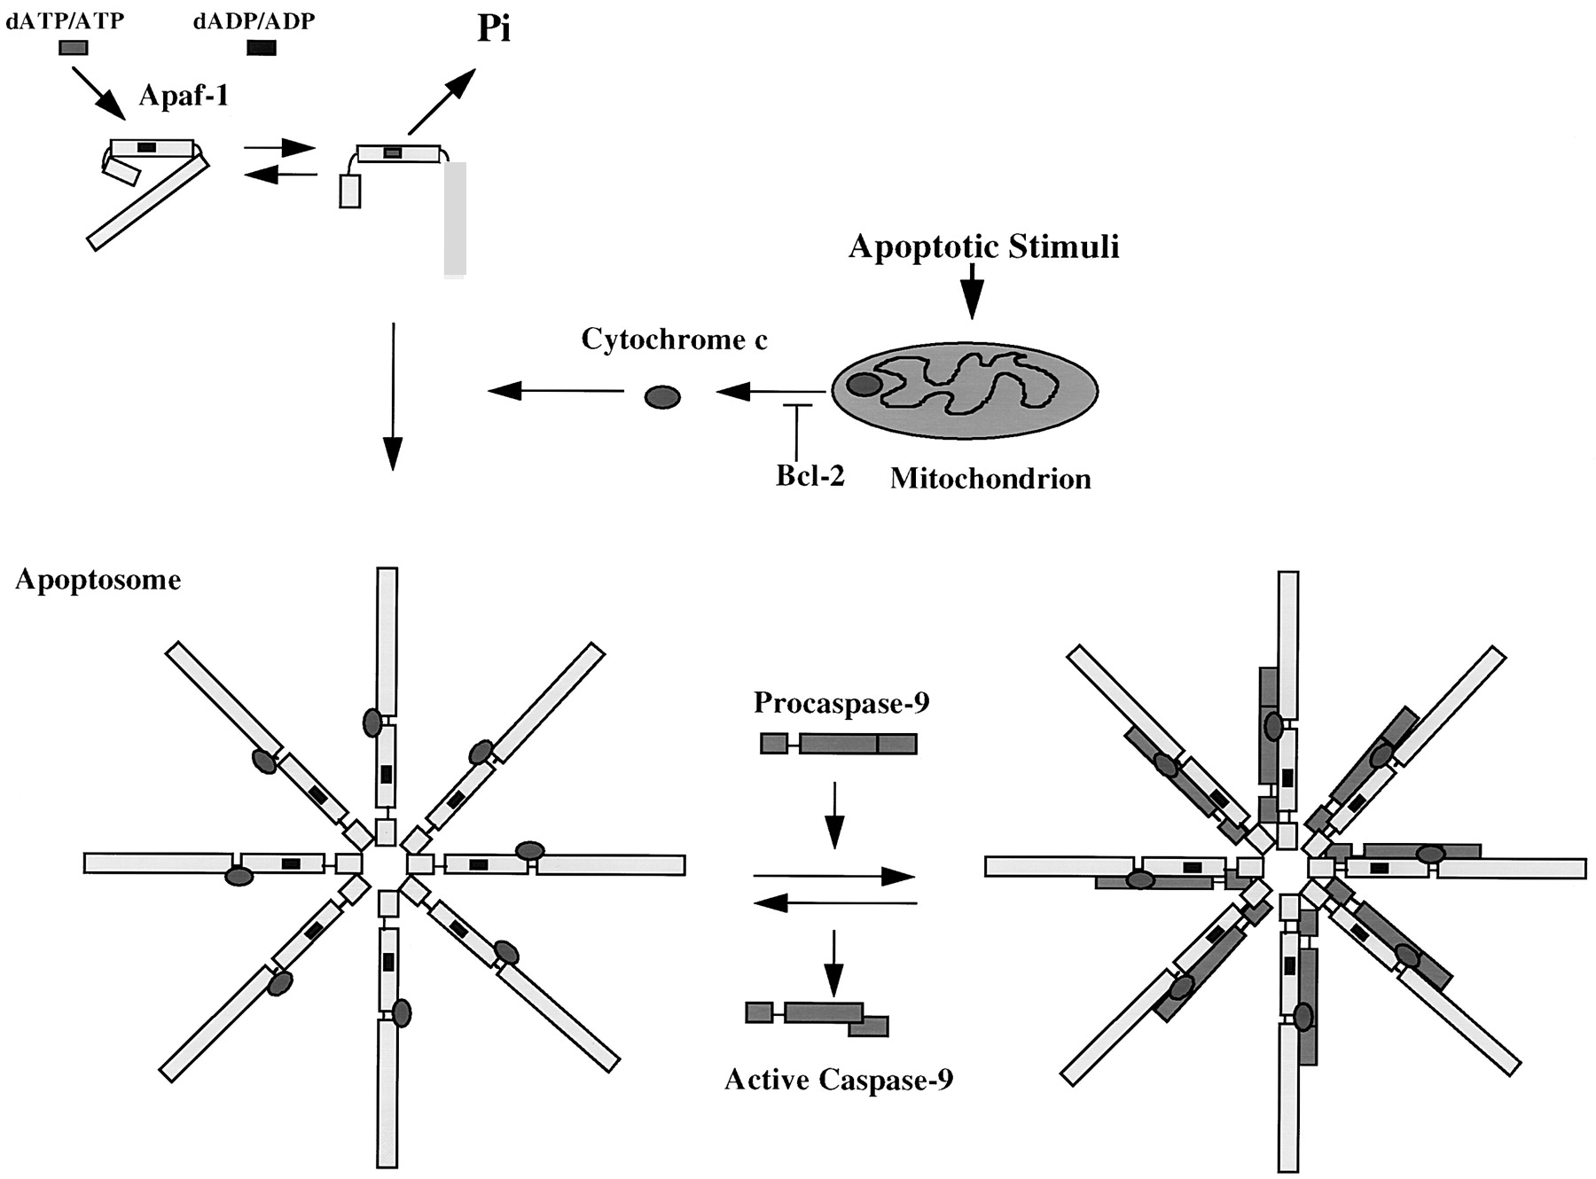
Model for Caspase Activation
Adapted from Zou et al. Cell 86 147-157, 1997

Slide 5
Discovery of Bcl-2
In 1986, three groups independently cloned bcl-2 oncogene. bcl-2 oncogene causes follicular lymphoma and is a result of chromosome translocation [t(14;18] that has coupled the immunoglobulin heavy chain locus to a chromosome 18 gene denoted bcl-2
In 1988, Vaux, Cory, and Adams discovered bcl-2 oncogene causes cancer by inhibiting lymphocyte cell deaths, providing the first evidence that cancer can result from inhibition of cell death
1990, Stanley Korsmyer’s group showed Bcl-2 localized to mitochondria

Slide 6
C. elegans ced-9 Gene Is a Functional Homologue of Bcl-2
A gain-of-function mutation in ced-9 protects against all cell deaths in nematodes, while loss-of-function mutations cause massive ectopic cell deaths
ced-9 encodes a protein similar to Bcl-2
Bcl-2 inhibits cell death in nematodes and can partially substitute for ced-9
CED-9 is localized at mitochondria

Slide 7
Bcl-2/ced-9 Define a Family of Cell Death Regulators
Korsmyer’s group purified a protein, Bax, that associates with and modulates the activity of Bcl-2. Bax by itself can also cause apoptosis in a Bcl-2-independent and caspase-independent manner.
Thompson’s group identified a gene, named bcl-x, which can be alternatively spliced to generate two proteins that have opposite functions in apoptosis. The long form (Bcl-xL) inhibits apoptosis and the short form (Bcl-xs) cause cell death.
Korsmyer’s group identified another Bcl-2-interacting and death inducing-protein, Bid, which only has one Bcl-2 homology domain (BH3).
Subsequently, more Bid-like death-inducing proteins were identified, all of which has only one BH3 domain. This protein family was called BH3-only Bcl-2 subfamily.

Slide 8
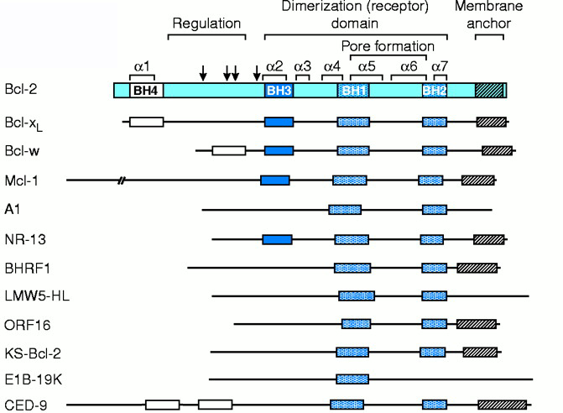
Anti-apoptotic Bcl-2 family members
Adapted from Adams and Cory, Science 281, 1322-1226, 1998

Slide 9
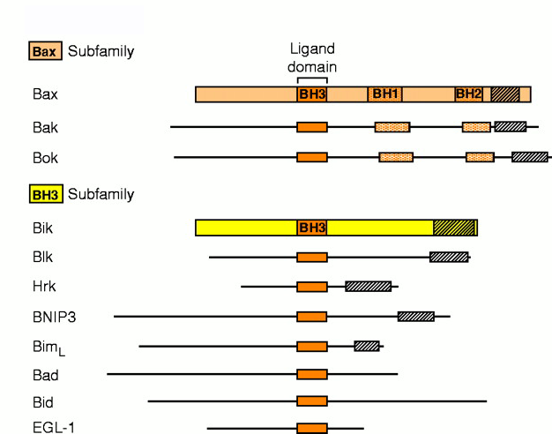
Pro-apoptotic Bcl-2 family protein
Adapted from Adams and Cory, Science 281, 1322-1226, 1998

Slide 10
Key Features of Bcl-2 Family Proteins
They localize either inducibly or constitutively to outer membranes of mitochondria and nuclei, and membranes of ER
They are capable of forming heterodimers with other family members, especially those with an amphipathic helical BH3 domain
Some of them are capable of forming ion-conducting channels on synthetic membranes

Slide 11
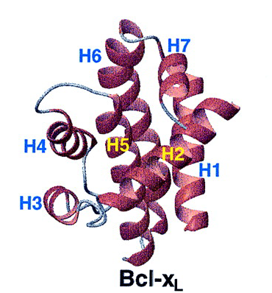
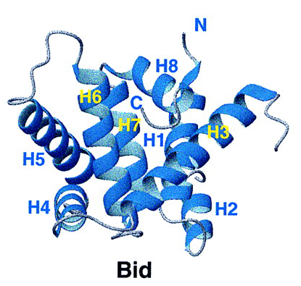
Structures of Bcl-xL and Bid
BH3
BH3
Adapted from Chou et al., Cell, 1322-1226, 1999

Slide 12
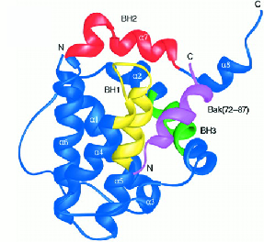
Structure of the Bcl-xl/Bak Complex

Slide 13
Bcl-2 Family Proteins and Cancer
Overexpression of Bcl-2 caused follicular lymphomas
Mutations in Bax cause human gastrointestinal cancer and some leukemias.
In many tumor cell lines, the expression levels of pro- and anti-apoptotic Bcl-2 family members are altered.

Slide 14
Model for Caspase Activation
?
Adapted from Zou et al. Cell 86 147-157, 1997

Slide 15
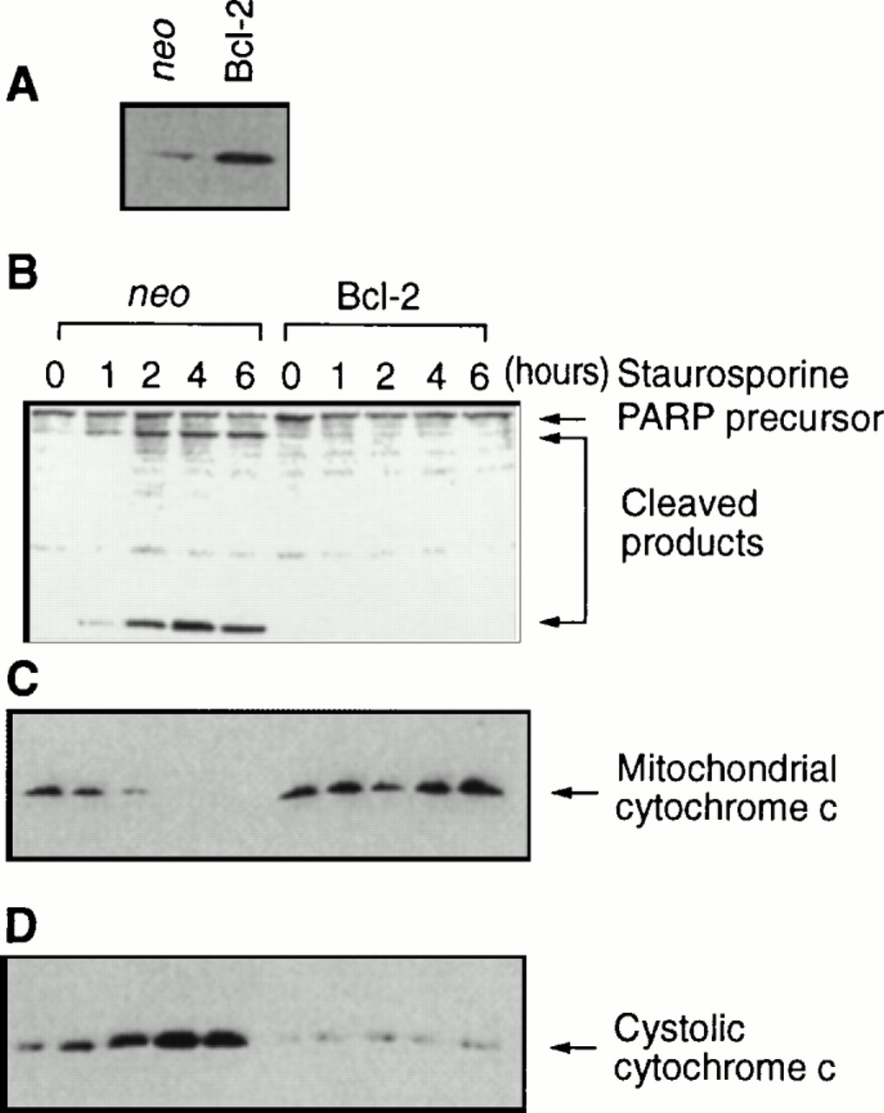
What controls cytochrome c release?
Yang et al. Science 275, 1129, 1997

Slide 16
Bcl-2 prevents cytochrome c release from mitochondria

Slide 17
Cell Death Pathway is conserved from C. elegans to Humans
Worm
e
g
l
-
1
c
e
d
-
9
c
e
d
-
4
c
e
d
-
3
Human
BH3-only
Protein
(Bid and Bim)
Bcl-2
Apaf-1
PCD
C
a
s
p
a
s
e
Horvitz (2003). Chembiochem. 4, 697-711.

Slide 18
Programmed Cell Death
Death Signaling Pathways

Slide 19
What are the signalling pathways that
activate cell death program?
Sex hormones
?
Growth factor
?
withdrawal
?
?
Genotoxic insults
?
?
death protease
?
PCD
activation
Cell cycle perturbation
?
?
?
?
Genetic mutations
?
?
?
Death factors
Death factors

Slide 20
TNF/FASL
TNF is a protein toxin which is secreted by activated macrophages and monocytes
Laster et al., using time-laspe video microscopy observed that TNF can cause target cells to adapt morphology typical of apoptosis. (1988)
A Japanese group purified a cell-killing mAb to a surface antigen called FAS that causes cytotoxic activity very similar to that caused by TNF (1989).

Slide 21
TNF/FASL
Functional and soluble forms of TNF and FasL exist as trimers.
Monovalent (Fab fragment) and divalent anti-Fas or anti-TNF antibody can not induce cell death. Only the IgM class anti-Fas or IgG3 class anti-Fas antibody that have the tendency to aggregate can activate these receptors
The receptors need to be oligomerized to be activated.

Slide 22
TNFR/FAS
In 1990, many groups simultaneously cloned two TNF receptors (TNFR1 and TNFR2).
In 1991, by expression cloning, Shige Nagata’s group cloned FAS and found that it is a surface protein with a single transmembrane domain and shares homology with TNF receptors.
An eighty amino acid domain in the cytoplasmic region of Fas and TNFR are found to be important for inducing apoptosis by mutational and deletion analysis. This domain is called “death domain”.

Slide 23
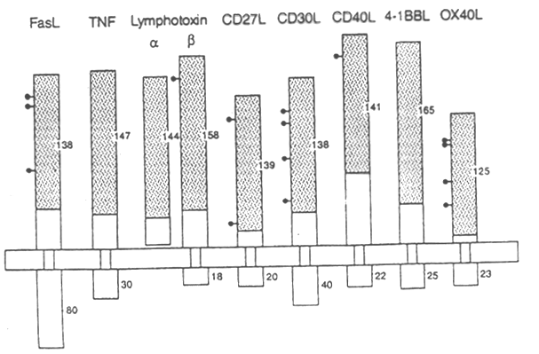
TNF Family
TNF, lymphotoxin, CD30 ligand, CD40 ligand, CD27 ligand, TRAIL, and FAS ligand.
Type II-membrane protein and the extra-cellular region of about 150 amino acids is well conserved.
Most often they can be proteolytically processed to generate soluble form. But membrane bound forms are more potent in their activity. Soluble forms often exist as trimers.

Slide 24
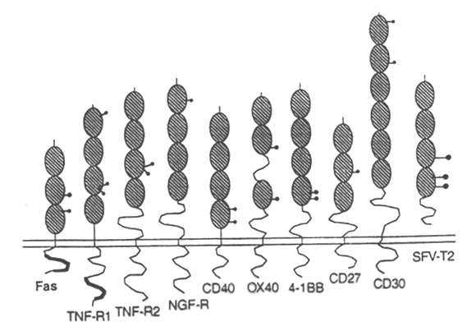
TNF Receptor Family
Type I membrane protein
contains 3-6 cysteine-rich domain
TNFRI and FAS have an 80-amino-acid homologous domain in their cytoplasmic tails--”death domain”

Slide 25
Identification of Downstream Pathways of FAS/TNFR
1) Wallach’s and Dixit’s groups using yeast two hybrid screen isolated MORT-1/FADD. MORT-1/FADD has a “death domain” at its C terminal and a so-called “death effector” domain at the N terminal which by itself can induce PCD. MORT-1/FADD interacts with Fas through its “death domain”.
Death Effector Domain
Death Domain
1
208
FADD/Mort-1
2) Goddel’s group using similar approach isolated TRADD as the interacting protein of TNFRI. TRADD has a “death domain” but no “death effector domain”.
1
Death Domain
312
TRADD

Slide 26
Identification of Downstream Pathways of FAS/TNFR
Wallach’s group carried out one more round of the two-hybrid screen using MORT-1/FADD as a bait and isolated MACH/FLICE as a FADD-interacting protein.
Death Effector Domains
FLICE
FLICE(caspase-8) has two death-effector domains at its N-terminal right before its caspase protease domain and interacts with MORT-1/FADD through its “death-effector domain”.
TRADD can interact with MACH/FLICE through FADD

Slide 27
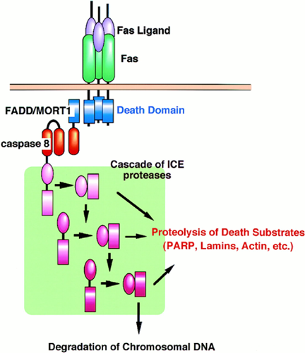
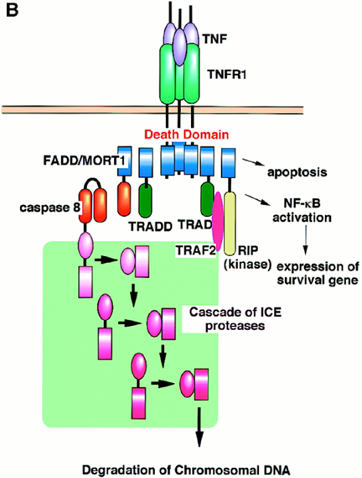
FAS/TNF Death Signaling Pathway
Adapted from Nagata S. Cell 1997

Slide 28
Extra Twist on the FAS Death Signaling
Peter Krammer’s group at Germany carried out a careful time-course study of Fas-induced cell death in many different cell types. They observed two different kinds of responses. In type I cells, caspase-3 activation is within 30 mins of receptor engagement, while in type II cells, caspase-3 activation was delayed for 60 mins. Fas-induced cell death in type II but not type I cells can be blocked by Bcl-2 or Bcl-XL.
Activation of FAS leads to release of Cytochrome C, which can be blocked by z-VAD-fmk, a broad range caspase inhibitor, or Bcl-2 and Bcl-xL.
Active caspase-8 can induce Cytochrome C release from mitochondria in a cell-free system in Xenopus.

Slide 29
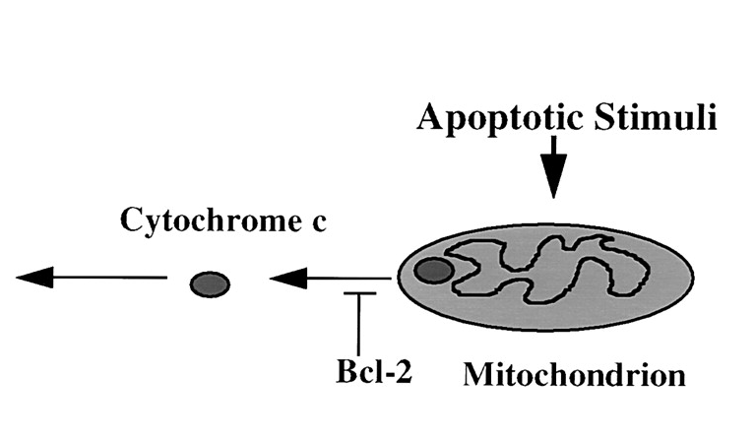
?
Apoptosis

Slide 30
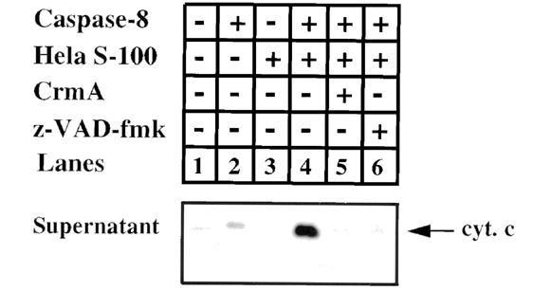
Purification of Cytochrome C releasing factor
Caspase-8+Hela S100
+purified Mitochondria
Hela S100
Cytochrome C release
Bid
?
+Caspase-8
Mitochondria
Translocate to mitochondria
BH3
Caspase-8
+
BH3
Bid
tBid
A cytoplasm protein
Adapted from Luo et al. Cell 1998

Slide 31
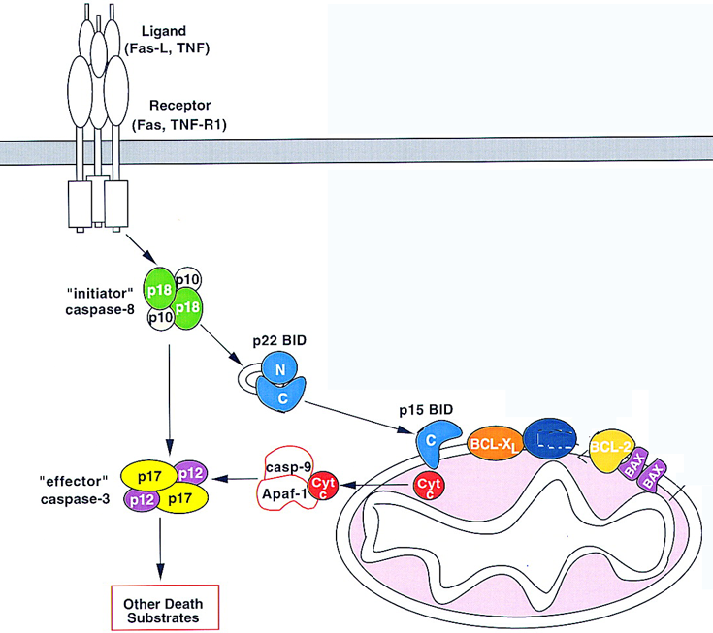
Two Parallel FAS Death Pathways
Adapted from Gross et al.
Gene & Development 1999

Slide 32
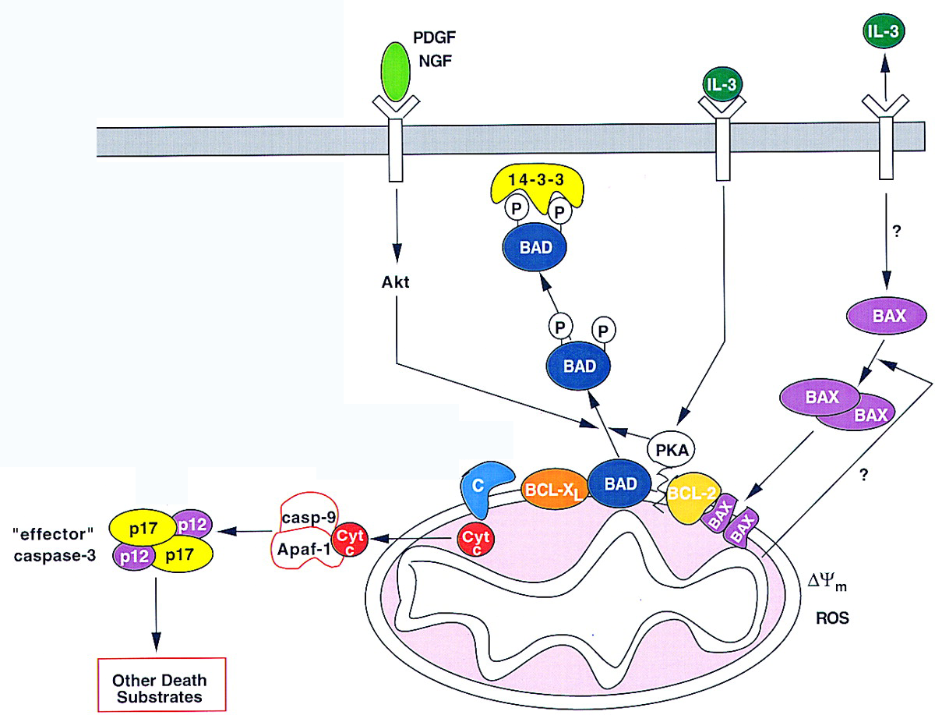
Death Pathways Induced by Growth Factor Deprivation
Adapted from Gross et al.
Gene & Development 1999

Slide 33
Cytochrome c release is sufficient to induce apoptosis?
Microinjection of Cytochrome C can not induce apoptosis in
certain cell types

Slide 34
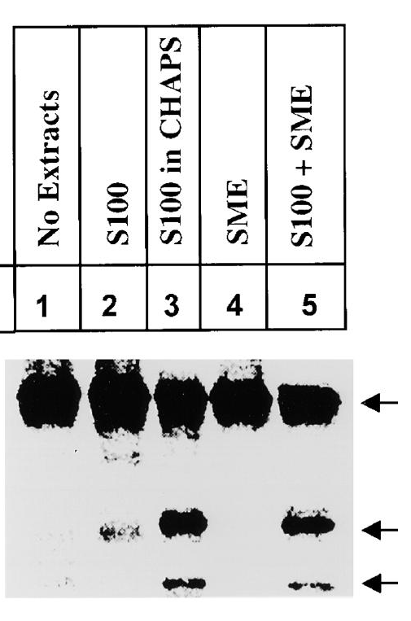
Smac--Second Mitochondria Derived Activator of Caspases
Hela S100 prepared with buffer containing detergents
is more active in activating caspases
SME
(solubilized membrane extract)
+S100
Pro-caspase-3
SMAC
(mitochondria protein)
Cleaved products
Adapted from Du et al. Cell 2000

Slide 35
SMAC and IAPs
SMAC encodes a novel protein.
SMAC interacts with IAP proteins
Members of IAP family directly inhibit the activation and protease activities of caspases
SMAC removes the inhibition of IAPs on caspases.

Slide 36
IAP Family
First identified in the baculovirus genome as inhibitors of apoptosis.
All contains at least one BIR domain (baculovirus IAP repeat).
Some family members (XIAP, cIAPs, Survivin, DIAP1) are potent inhibitors of apoptosis, by inhibiting the activation or activities of some caspases (caspase-3, caspase-7 and caspase-9).
Some family members regulate Chromosome segregation and cytokinesis.
Survivin is upregulated in many cancer cells but not in differentiated cells, making it a new tumor marker.

Slide 37
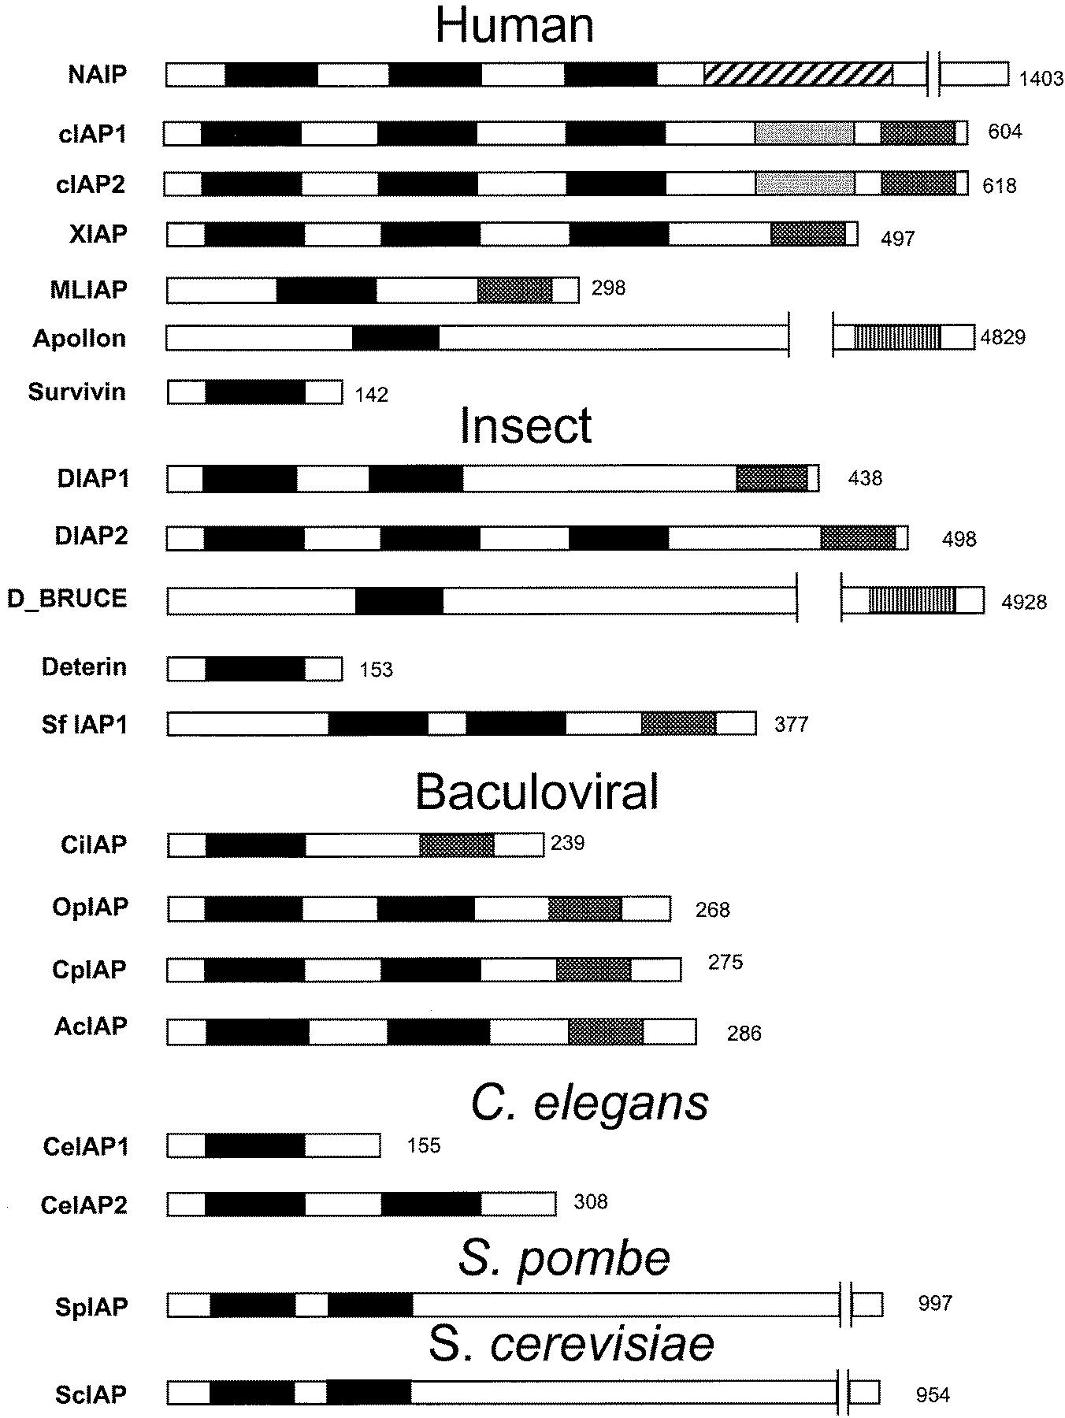
IAP Family

